Slide 1
Introduction to DevOps
TOPIC
UTM-SERG Research & Consultancy Team
School of Computing
Faculty of Engineering
Universiti Teknologi Malaysia
UTM, Skudai, Johor.

Slide 2
Introduction
DevOps - WHAT, WHY
  Continuous Integration
  Continuous Delivery
  Continuous Testing

Slide 4










Software delivery
Big Data
Insights on new products by more efficiently interpreting massive quantities of data
Cloud
Demand for apps requires fast, scalable environments for dev
and test, as well as production
Social Business
Broader set of stakeholders collaborates to deliver continuous innovation
and value
Instrumented Products
Industry requirements demand faster response to regulations
and standards, with traceability and quality
Software delivery
Mobile
Modern workforce
expects constantly
updated software to
connect to enterprise systems
Intelligent/
Connected Systems
Software component in smart products driving increased value and differentiation
Notes:
Drury Design Dynamics
IBM Innovate 2013

Slide 5


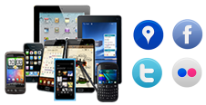
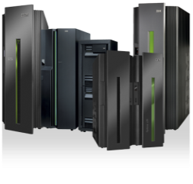



A lack of continuous delivery Of Interaction”
Line-of-business
Takes too long to introduce or make
changes to mobile apps and services
Operations
Rapid app releases impact system stability and compliance
>70%
of budgets devoted
to maintenance
and operations
Systems of Interaction
>45%
of customers experience production delays
Systems of Engagement
Systems of Record
CRM
HR
DB
ERP
4-6 weeks
to deliver even minor application changes to customers
MF
iSeries
>50%
of outsourced
projects fail to
meet objectives
Continuous
client experience
Cloud-based
Services
Partner
value chain
Development/Test
Speed mismatch between faster moving front office and slower moving back office systems, delaying time to obtain feedback
Suppliers
Delivery in the context of agile

Slide 6


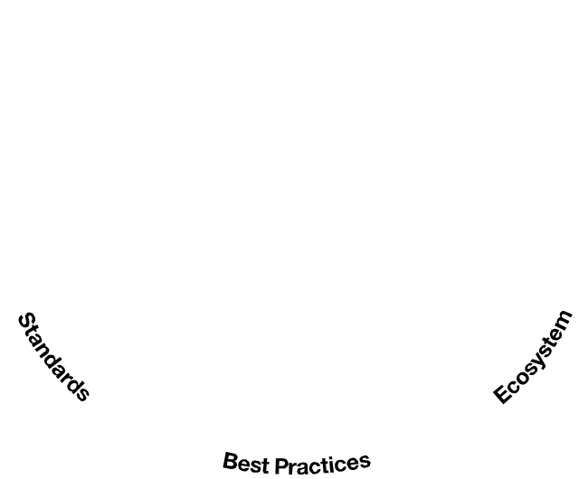








DevOps
Continuous
Business Planning
Accelerate
software delivery
faster time to value
Plan
& Measure
Continuous
Monitoring
Collaborative Development
Continuous
innovation,
feedback and improvements
Balance speed, cost, quality and risk
increased capacity to innovate
Monitor
& Optimize
Develop
& Test
Continuous
Customer Feedback and Optimization
Release
& Deploy
Continuous
Testing
Reduce time to customer feedback
improved customer experience
Continuous Release and Deployment

Slide 7
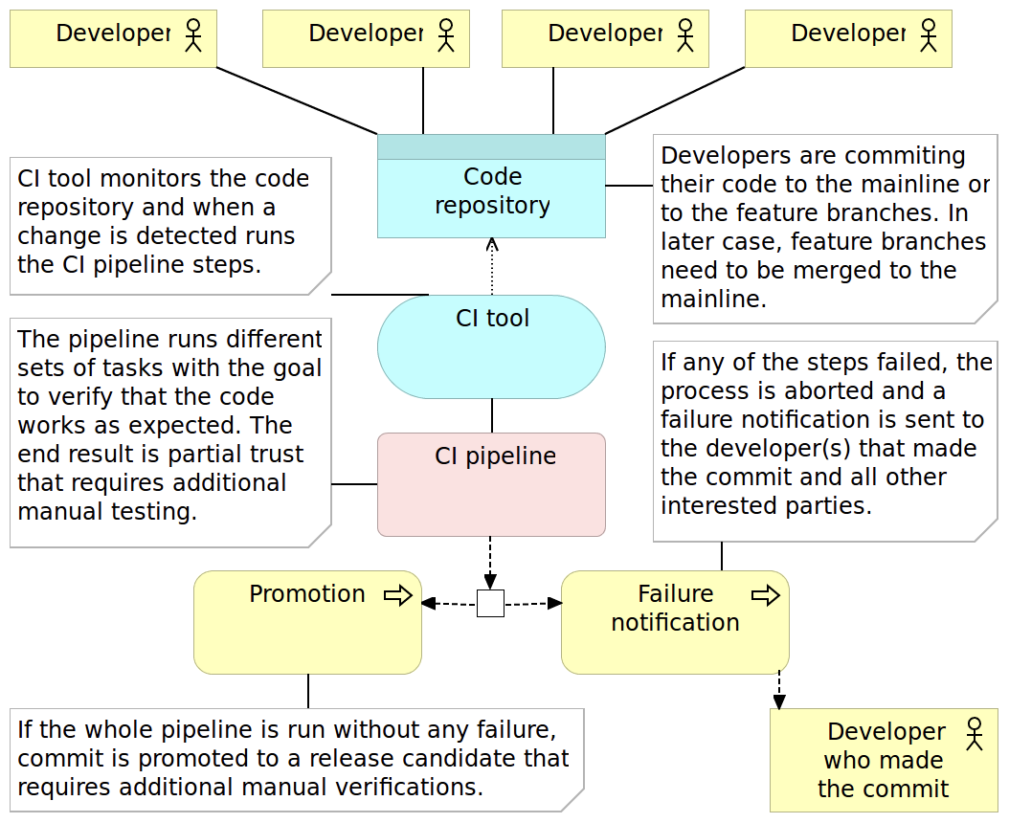
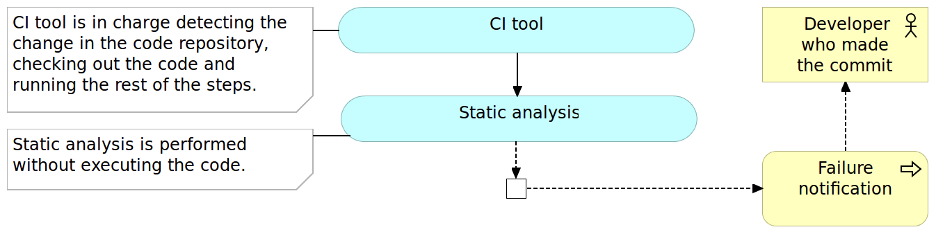
Continuous Integration
CI Process
CI Pipeline

Slide 8
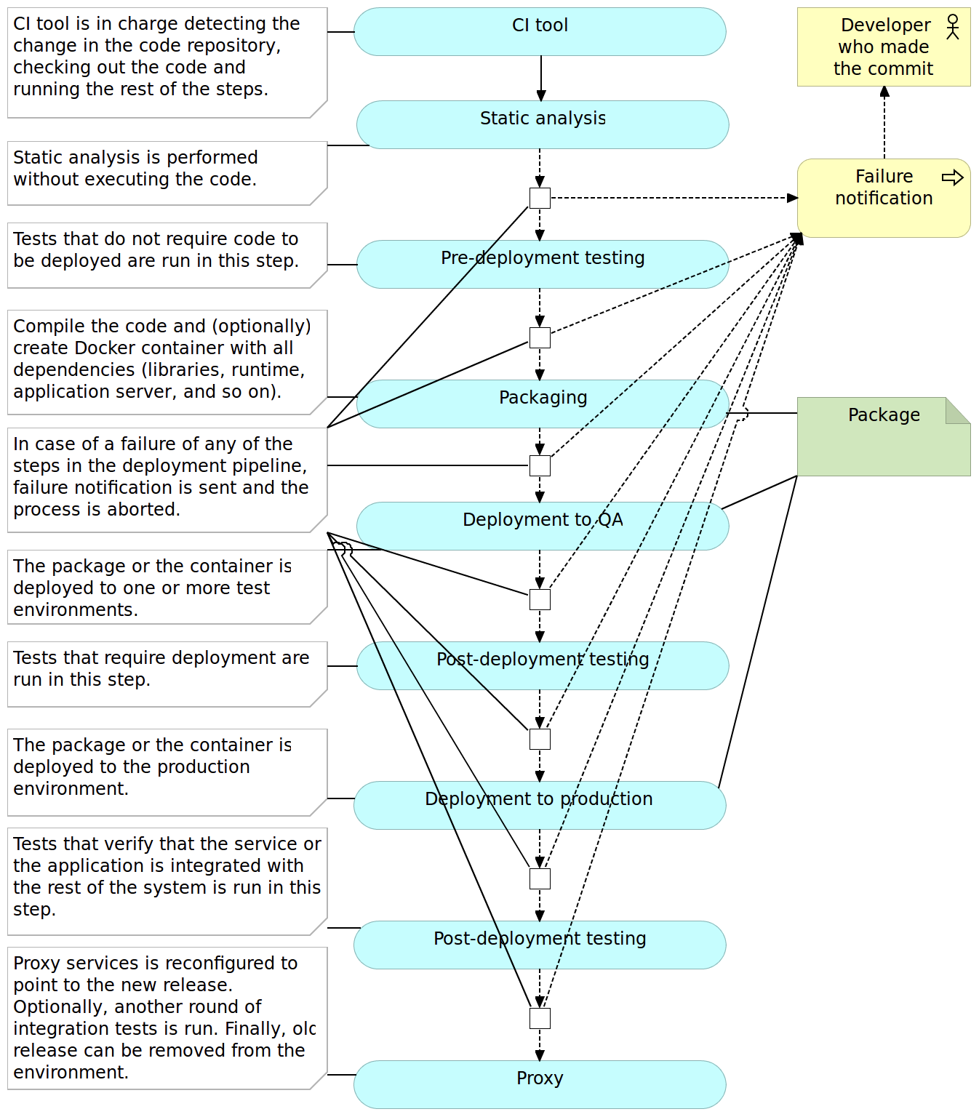
Continuous Delivery

Slide 9
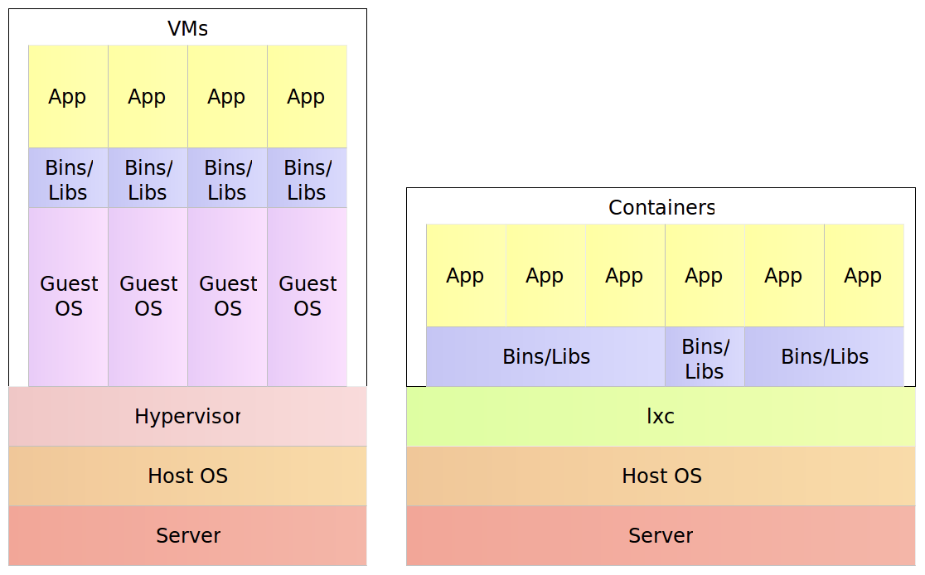
container

Slide 10
DevOps and Cloud adoption
Traditional
On-Premises
Infrastructure
as a Service
Platform
as a Service
Applications
Applications
Applications
Self Setup
Data
Self Setup
Data
Data
Mid Config
Mid Config
Mid Config
Man/Auto
Middleware
Man/Auto
Middleware
Middleware
O/S
O/S
O/S
Virtualization
Virtualization
PureApplication System
SmartCloud Orchestrator
SoftLayer
Virtualization
Manual
Servers
Servers
Servers
Storage
Storage
Storage
Networking
Networking
Networking
Customization; higher costs; slower time to value
Standardization; lower costs; faster time to value

Slide 11
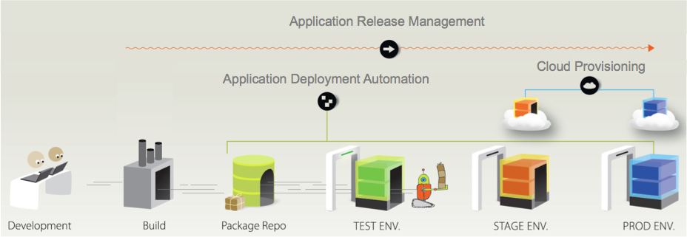



DevOps Solution
Line of Business
Jenkins

Slide 12
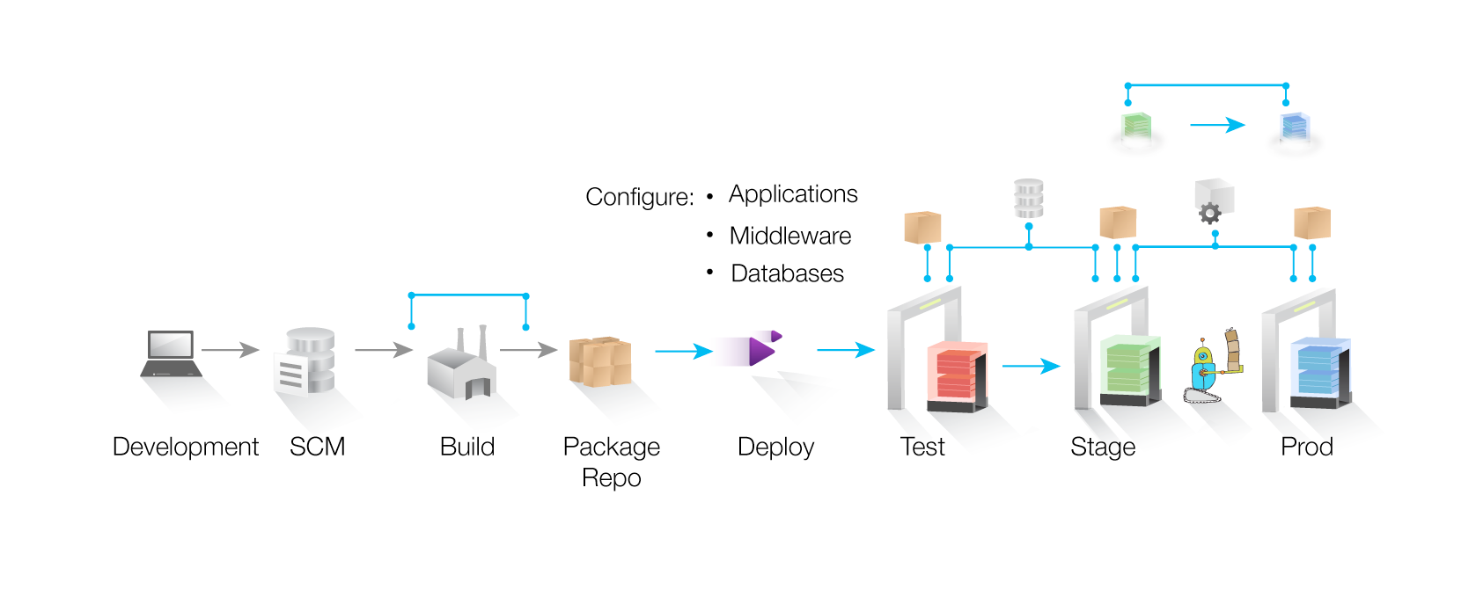
DevOps Solution
Drive down cost
Remove manual effort and wasted resource time with push button deployment processes
Speed time to market
Simple, graphical process designer, with built-in actions to quickly create deployment automation
Reduce risk
Robust configuration management, coordinated release processes, audits, and traceability

Slide 13





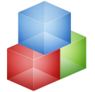


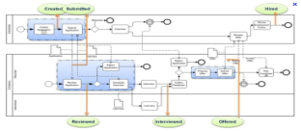
DevOps Solution
Monitoring
Network Domain
IT Management
IT Asset Management
Monitoring Domain
Storage Domain
Storage Domain
Compute Domain
Data Availability Domain
Network Domain
Change Management
Orchestrate
Orchestration Engine
DB
Service Desk
Web
App
Provision Pattern
Resource Orchestration
Onboard, provision, manage CPU, Storage and Network
Workload Orchestration
Workload aware placement, optimization and operation
Service Orchestration
Manage the lifecycle of business applications

Slide 14



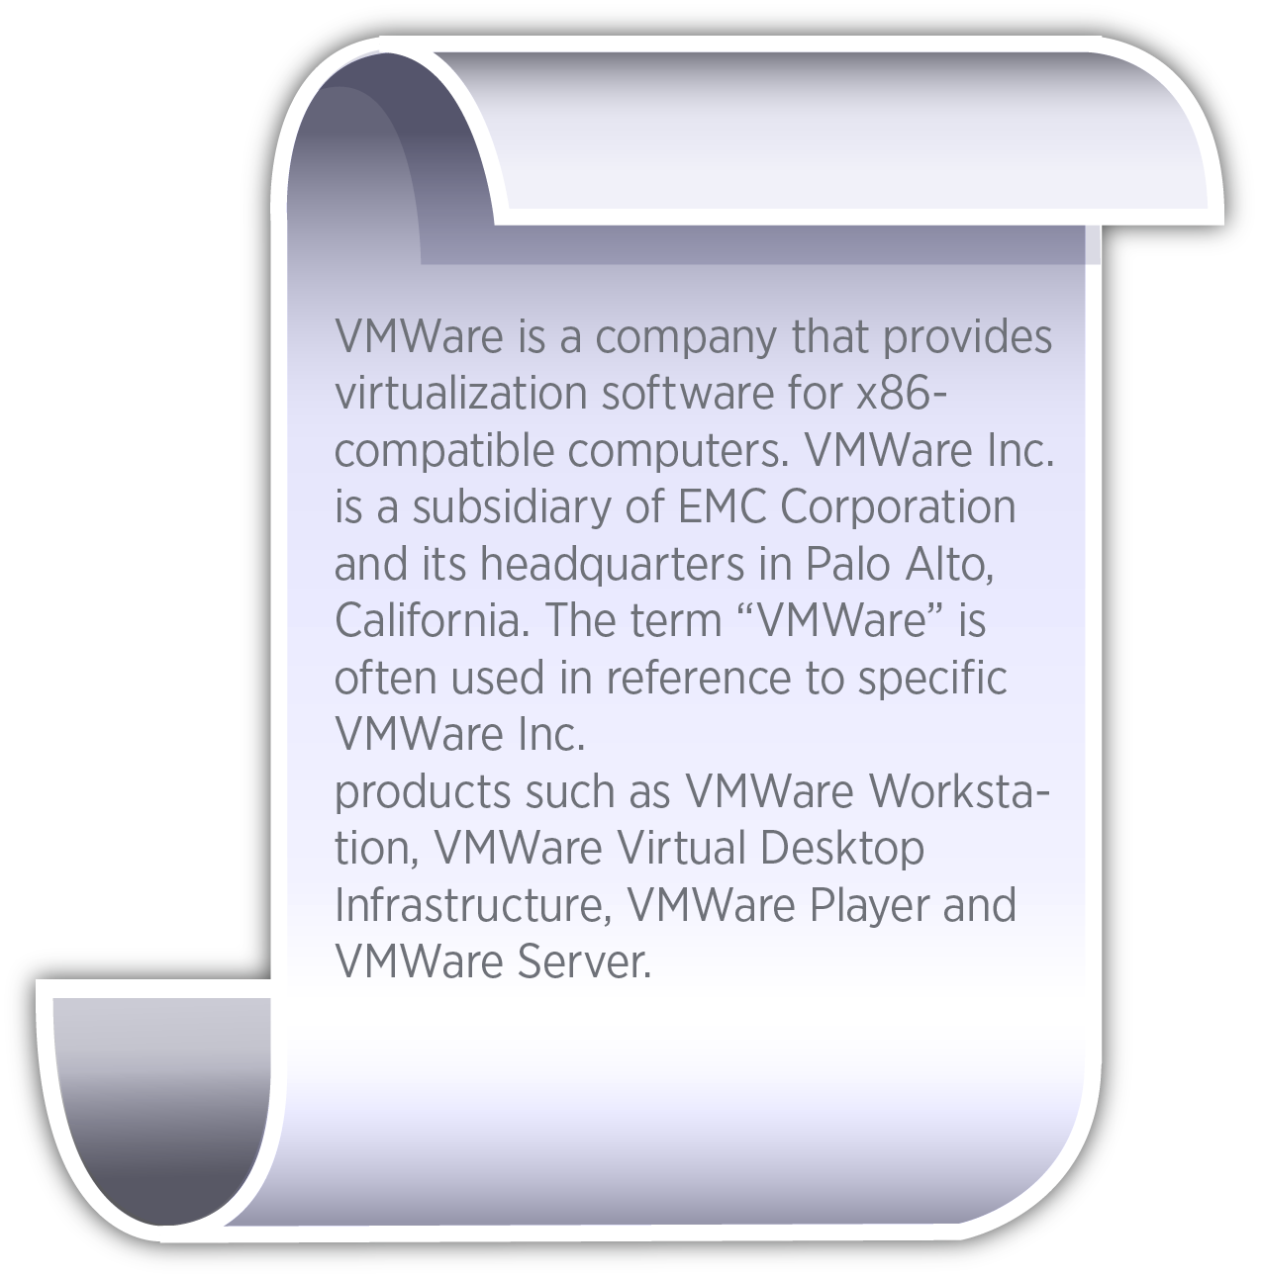

Automating application deployment to cloud resources
Deployment
World-Wide Banking Application
war
ddl
mq
Application
Environments
Component
DEV
QA
...
PROD
Cloud Resources (DEV)
Cloud Resources (PROD)
World-Wide Banking Application
World-Wide Banking Application
war
ddl
mq
war
ddl
mq
Pattern Parameters
can be supplied by
Properties from
UC Deploy
Tomcat
MySQL
JMS
WebSphere Liberty
DB2
WSMB

Slide 15

Improve Delivery Lifecycle with Software
Defined Environments
SCM
Build Automation
Pull changes
Publish build
Jenkins
Execute application deployment and manage settings across environments
Deploy early and often to ensure higher quality and faster releases using repeatable, reliable, and managed automation
DEV
QA
PROD
DEV
DEV
Environments
DEV

Slide 16









Continuous testing
Combining continuous testing with
Deployment automation and service virtualization for reducing time to market and improving quality
{
Test Environments
Jenkins
virtual components
integrated with
Databases
Internal
Messages
Third-party
Services
Test Tools
Deploy what is ready, virtualize the rest
Test Tools
Continuously test in production-like env.
Dev
QA
Simultaneously test across multiple test stages
n
Test using real world network conditions
Test Tools
Dynamic Infrastructure
Provision
Deploy
Test

Slide 17
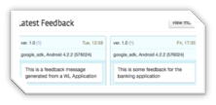
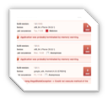
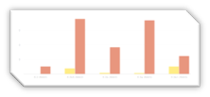
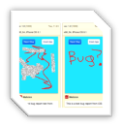





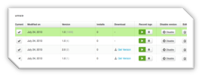

Quality Assessment
User Feedback
Crash logs
4
Crash log reporting
Bugs vs. Crashes
Bugs
LOB/Digital Marketer
Developer
Tester
End Users
2
5
Sentiment Analysis
1
Over the air build distribution
In app bug reporting
3
In app user feedback
Quality Dashboard
with Sentiment Analysis
Builds

Slide 18



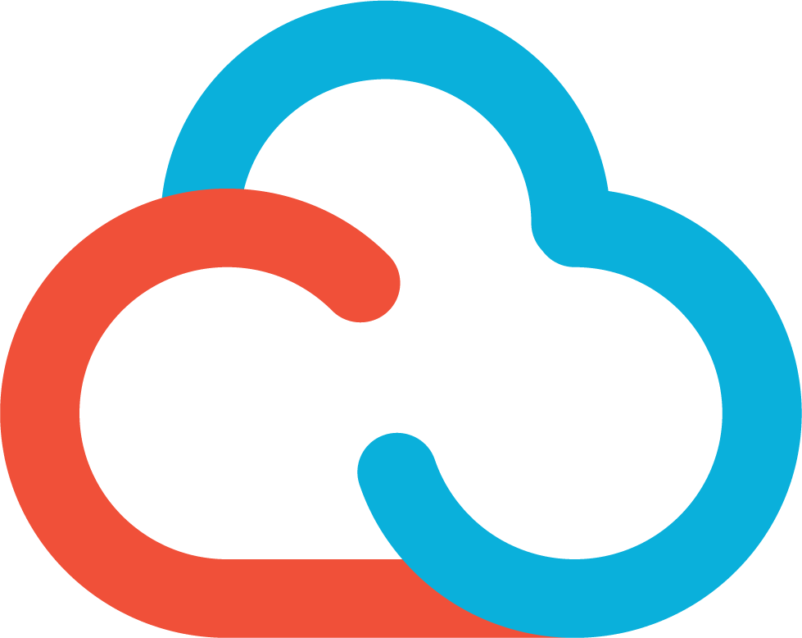


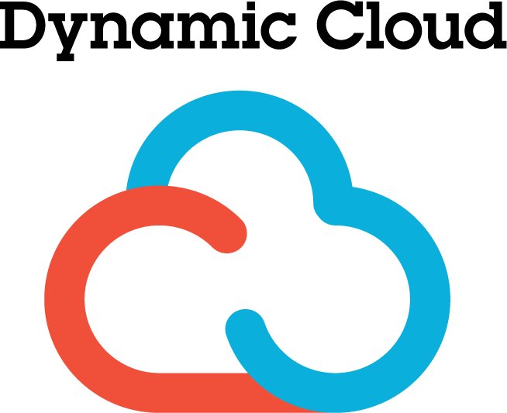
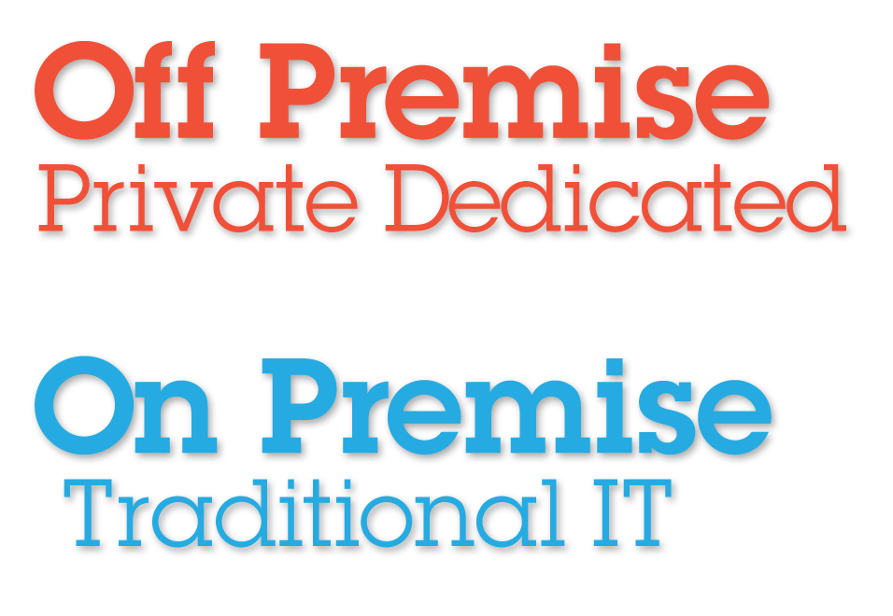


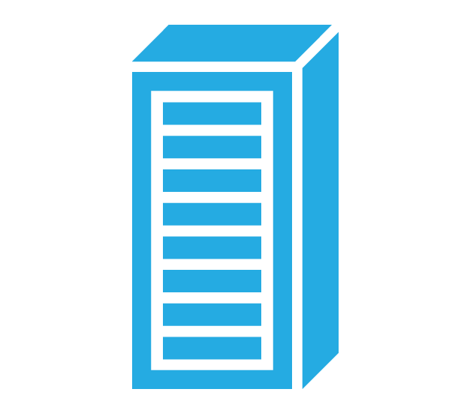
Moving to open technologies
Applications
Banking Application
Application template
Environments
Application
Lifecycle
DEV
TEST
QA
PROD
Orchestrator
Banking Application
Banking Application
Infrastructure
template
Heat Orchestration Template (HOT)
Heat Orchestration Template (HOT)
Hardware
Network
Server
Storage
Network
Server
Storage
Public
Dedicated
Traditional
IT
Private

Slide 19


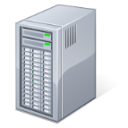
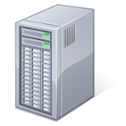
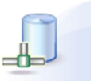
Globally distributed enterprise deployments
Data Center A
Data Center B
Clustered High Availability
Agents
Clustered High Availability
Agents
Relay Server
Relay Server
Load Balancer
Load Balancer
Associated servers across sites
Shared by servers
Shared by servers
DB
CodeStation
DB
CodeStation
Replicate deployment artifacts
Synchronize data (e.g. process definition, security, templates)
Awareness-only of other (e.g historical data)

Slide 20
